Slide 1
Churn Costumers

Slide 2
Dataset and preparation: The dataset of churn contains 14 columns. customerID, tenure, PhoneService, Contract , Paperless, PaymentMethod, MonthlyCharge, MontlyGroceryspent, Revenue, gender, Age, Partner, N_dependent and Churn as dependent variable. Monthly Charges has 12, churn 52 and revenue 44 missing values. median is used to replace revenue and monthly charges missing values, and “Undecided” for the 52 missing values for y=churn. After cleaning we have 7042 rows of data. Encoding on categorical variables, Phone Service with 2 levels yes=1, no=0, Contract with 3 levels month-to-month=1, one-year=2 and two-year=3, Paperless with 2 levels yes=1, no=0, PaymentMethod with 4 levels Bank transfer (automatic)=1, Credit card (automatic)=2, Electronic check=3 and Mailed check=4, gender with 2 levels male=1 and female=2, Partner with 2 levels yes=1, no=0, churn with 3 levels undecided=1, no=2 and yes=3 is done.
customerID | tenure | Phone Service | Contract | Paperless | Payment Method | Monthly Charges | Monthly Grocery spent | Churn | Revenue | gender | Age | Partner | Dependents | N_ dependent
6823-SIDFQ | 28 | Yes | One year | No | Credit card (automatic) | 18.25 | 259 | No | 22024 | Male | 53 | No | No | 0

Slide 3
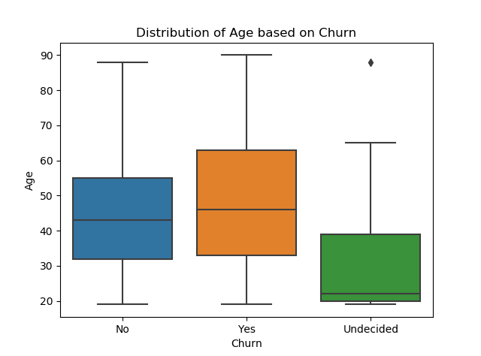
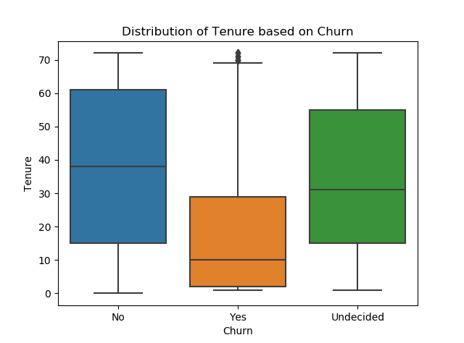
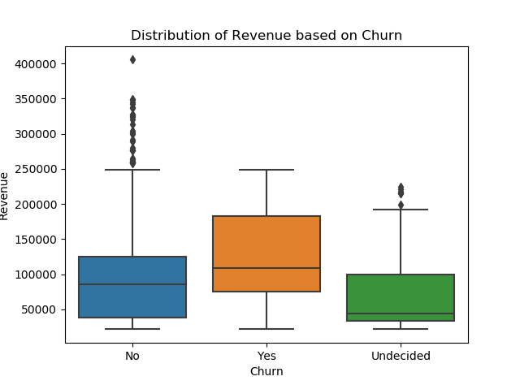
Distribution of variables: Average of age, tenure and revenue for different levels of churn. Apparently the undecided ones are from younger ages. Those who decided to churn have lower tenure and those who do not want to churn are mostly from lower income with some outliers of high incomes.
Churn | Age | tenure | Revenue
Yes | 47.65 | 17.95 | 117474.57
No | 44.48 | 37.61 | 95520.22
Undecided | 29.19 | 34.49 | 73489.66

Slide 4
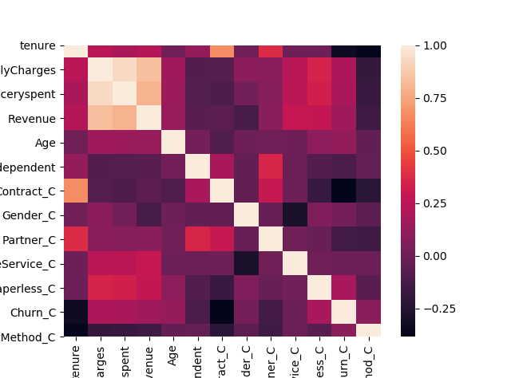
Correlation and association between variables:
There is pretty high correlation between y=churn and some dependent variables. Also some of the dependent variables are highly correlated with each other.
 | tenure | Monthly Charges | Monthly Grocery spent | Revenue | Age | N_ dependent | Contract_C | Gender_C | Partner_C | Phone Service_C | Paperless_C | Churn_C | Payment Method_C
tenure | 1
MonthlyCharges | 0.2470 | 1
MonthlyGroceryspent | 0.1999 | 0.9310 | 1
Revenue | 0.2309 | 0.8384 | 0.7980 | 1
Age | 0.0149 | 0.1593 | 0.1522 | 0.1452 | 1
N_dependent | 0.1343 | -0.0831 | -0.0778 | -0.0658 | 0.0295 | 1
Contract_C | 0.6715 | -0.0750 | -0.1018 | -0.0526 | -0.0927 | 0.1922 | 1
Gender_C | 0.0173 | 0.0999 | 0.0261 | -0.1227 | 0.0054 | -0.0329 | -0.0304 | 1
Partner_C | 0.3800 | 0.0957 | 0.0841 | 0.0943 | 0.0187 | 0.3581 | 0.2951 | -0.0154 | 1
PhoneService_C | 0.0084 | 0.2474 | 0.2504 | 0.2867 | 0.0065 | -0.0041 | 0.0022 | -0.2824 | 0.0178 | 1
Paperless_C | 0.0060 | 0.3510 | 0.3351 | 0.2777 | 0.1130 | -0.0824 | -0.1770 | 0.0645 | -0.0148 | 0.0165 | 1
Churn_C | -0.3321 | 0.2058 | 0.2033 | 0.1624 | 0.1320 | -0.1074 | -0.3835 | 0.0275 | -0.1353 | 0.0056 | 0.1933 | 1
PaymentMethod_C | -0.3703 | -0.1919 | -0.1745 | -0.1530 | -0.0302 | -0.0258 | -0.2273 | -0.0491 | -0.1550 | -0.0041 | -0.0627 | 0.0945 | 1

Slide 5
Logistic Regression Model:
X = tenure, MonthlyCharges, MontlyGroceryspent,
Revenue, Age, N_dependent, Paperless_C,
PaymentMethod_C, Contract_C, Gender_C, Partner_C,
PhoneService_C and y = churn
By removing the variables that are not significant in the model. The final model is:
Accuracy for cross validation, having 7-fold is 0.7761
 | Churn=1 | Churn=2 |  | Churn=3
X | Coef | Coef | P>|z| | Coef | P>|z| | Min p
Intercept | -5.052 | 1.335 | 0.000 | -1.644 | 0.000 | 0.000
tenure | 0.145 | 0.813 | 0.000 | -0.929 | 0.000 | 0.000
Monthly Charges | -0.617 | -0.712 | 0.000 | 0.942 | 0.000 | 0.000
Age | -1.337 | -0.005 | 0.583 | 0.092 | 0.006 | 0.006
N_dependent | -0.472 | 0.145 | 0.010 | -0.098 | 0.433 | 0.010
Contract_C | 0.160 | 0.572 | 0.002 | -0.768 | 0.000 | 0.000
Gender_C | -0.343 | 0.100 | 0.001 | -0.031 | 0.791 | 0.001
PhoneService_C | 0.107 | 0.194 | 0.091 | -0.273 | 0.000 | 0.000
y | 1 | 2 | 3
1 | 0 | 29 | 5
2 | 0 | 1150 | 102
3 | 0 | 250 | 225
 | precesion | recall | f1-score | support
1 | 0 | 0 | 0 | 34
2 | 0.80 | 0.92 | 0.86 | 1252
3 | 0.68 | 0.47 | 0.56 | 475
Accuracy |  |  | 0.78 | 1761
macro Avg | 0.49 | 0.46 | 0.47 | 1761
weighted Avg | 0.75 | 0.78 | 0.76 | 1761

Slide 6
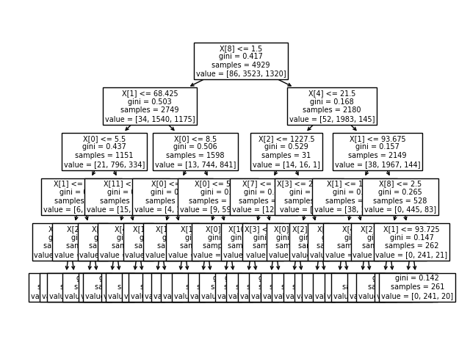
Decision Tree Model:
X = tenure, MonthlyCharges, MontlyGroceryspent, Revenue, Age, N_dependent, Paperless_C, PaymentMethod_C, Contract_C, Gender_C, Partner_C, PhoneService_C and y = churn with max depth of 5
y | 1 | 2 | 3
1 | 3 | 30 | 10
2 | 3 | 1311 | 218
3 | 0 | 229 | 309
 | precesion | recall | f1-score | support
1 | 0.5 | 0.07 | 0.12 | 43
2 | 0.84 | 0.86 | 0.85 | 1532
3 | 0.58 | 0.57 | 0.57 | 538
Accuracy |  |  | 0.77 | 2113
macro Avg | 0.64 | 0.5 | 0.51 | 2113
weighted Avg | 0.76 | 0.77 | 0.76 | 2113

Slide 7
The end thank you

